Slide 1
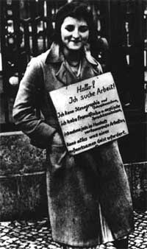
HISTORY
REVISION
Ana Rozman, Nejc Sedlar,
Mitja Primožič. Fatmir Behadini, Tine Lah, Vid Sopotnik, David Weiss

Slide 2

THE WEIMAR REPUBLIC
Democratic republic
They met in Weimar and wrote the constitution
The president was Ebert
First elections were held in January 1919
CRISES: inflation, econimic problems, reparations signed by The Treaty of Versailes

Slide 3
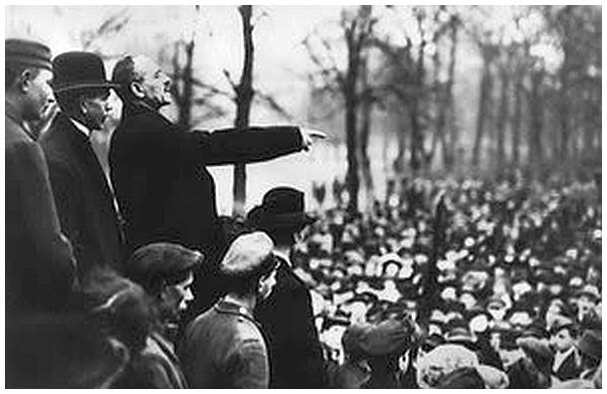
THE SPARTAKISTS AND THEIR REVOLUTION
Workers’ and soliders’ took over the power in cities
It caused chaos in 1918
The kaiser abdicated and Ebert took over with SDP
Communists didn’t
Want the elections, so
they revolted.
the spartakists lost
Against the Freikorps

Slide 4
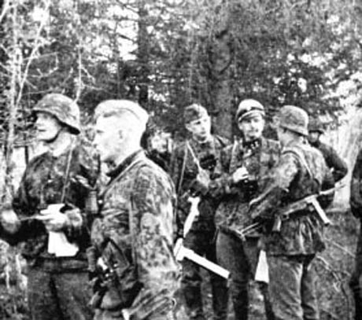
THE FREIKORPS
Fighting against the Spartakists
Ex service man who hated the socialists
Murdered Rosa Luxemburg & Karl Liebknecht
Ebert set them up
They won

Slide 5
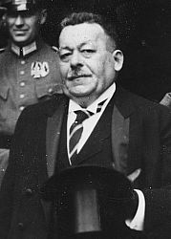
EBERT
SPD
He was elected as the leader of SPD
He changed between the left and the right wing
He was the first prime minister

Slide 6
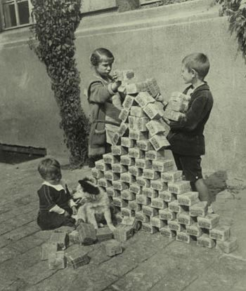
HYPERINFLATION
1923
Money was worth less and
less
Prices went up
It happened because of the
war reparations after the WW1
It ended with an introduction of a new currency
The stability and recovery were enabled by the Daws plan (US loans money)

Slide 7
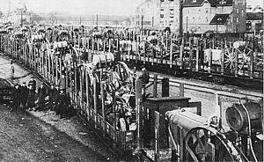
THE OCCUPATION OF THE RUHR
1923 the Ruhr
(Industrial city) was
occupied by the French
Because Germany
didn’t pay reparations
French belived they had the right to, because The Treaty of Versailess said so
Germans striked

Slide 8
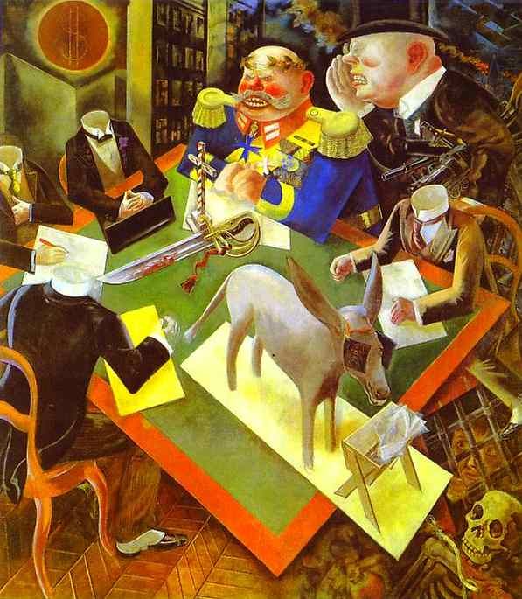
CULTURE IN WEIMAR GERMANY
Influenced by foering culutre
Decadent
Important
The number of theatres and cinemas was increasing rapidly, so was their popularity
Sexual & social themes, full of anti-war messages

Slide 9
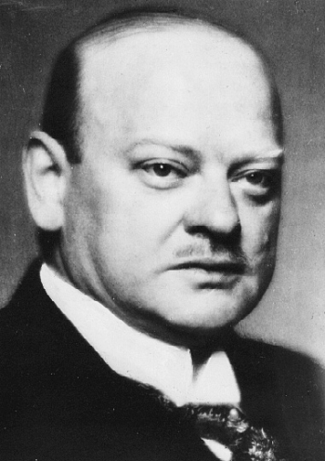
STRESSMANN
10/5/1878 – 3/10/1929
He wished to recover the
reichland
He combined stability on
the domestic front with
sicess abroad
Foering minister in Weimar
Germany
He helped to realize the Dews plan

Slide 10
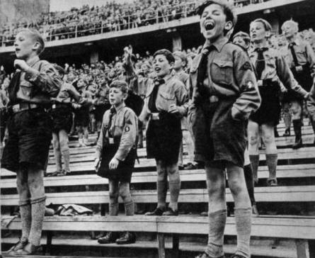
THE ORIGINS OF THE NAZI PARTY
Party is founded by far right
Political party 1920-1945
Created by Drexler
Nationalism + socialism
Grew from smaller
political groups

Slide 11
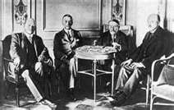
THE TREATY OF LOCARNO
Signed by Stresseman
To restore Germany
France & Britain treating Germany as an equal
Germany, Belgium and France agreed to refrain using the force to alert them
Britain & Italy guaranteed the treaty

Slide 12
WAS THE WEIMAR REPUBLIC DOOMED
It was
It had too many parties – no strong coalitional government
No party got a majority of the votes
Hard to make decisions
Hindenburg died, Hitler took over the power

Slide 13
THE MUNICH PUTSCH
1923
They met in a beerhall in Munich
Hitler & Ludnedorff
Hitler presented his plan and failed
They changet their mind because of Ludnedorff
They ended up in prision

Slide 14
THE WALL STREET CRASH AND THE GREAT DEPRESSION
1929 – 1933
The black Friday
Germany relied on USA from the Dawes plan from 1924
USA lost billions of $$
Banks went bust
People lost their savings, jobs...

Slide 15
HITLER BECOMES CHANCELLOR
1933
Appointed (not elected) by Hindenbur
They could control him
Part of Hiters plan
He became a dictator after Hindenburgs death – he took over the power

Slide 16
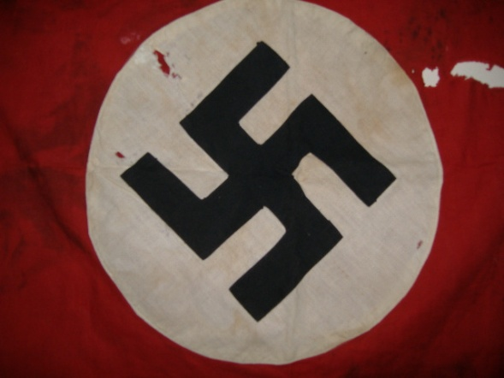
THE RESURGENCE OF THE NAZIS
They promissed the war to the people, to revenge the TOV
Because of the crises, people belived them
They had a strong army behind them
They had a strong propaganda

Slide 17
THE NAZIS ESTABLISH DICTATORSHIP
Began in 1933 – as Hitler was appointed chancellor
They got 92,2% of votes on elections
They dealed ruthlessly with their opponents (communists, raichstag fire)
As Hindenburd dies, Hitler becomes the leader
Army sweares an oath of eligence

Slide 18
VON PAPEN
He was a German nobel-man in romancatholic party
Chancellor in Germany
And a vice chancellor under Hitler
He belived Hitler could be controled one he will be in the government
He contributed to the fail of the Weimar republic

Slide 19
NAZI PERSECUTION
Persecution of minorities
6 million people were killed (Holocaust!)
They wated to seperate the Aryan race from other races
They established a ratial hygiene department
No rights for Jews, Gypsies, Blacks, Slaves...

Slide 20
THE DAWS PLAN
Germany bought its stability by a huge loan from USA
New current, to replace the old one
40 million pounds

Slide 21
NAZI POPULARITY
Very popular until they started loosing the war
Unemployment droped in the time of their dictatorship – because of the army
Nazis started living better
Not popular outside Germany

Slide 22
NAZI PROPAGANDA
Influence people through media
Wanted to establish external enemies
Internal enemies (Jews, Homosexual, Gypsies...)
Reaching out to Germans to other countries

Slide 23
NAZI LEADERS
Joseph Goebbels – joined in 1922, he was the minister of propaganda
Hermann Goring- head of the storm troopers, pilot
Heindrich Himmler – obcession of detail and accuaracy, Holocaust, involved in the Munich Putch, he was
Reimhart Heydrick – Himmlers suberdenet, cheaf of security services

Slide 24
THE NAZIS AND THE FAMILY
Family is very important
They incuraged marriages and births
Ideal family was: two aryan parents, strong man, beautiful women, and many many aryan children
Number of births was rising slowly
Easier to divorce if there were no children in the family

